Slide 1



Multimedia & Graphics
Class VI
lab 16

Slide 2


Clipart
simple pictures and symbols made available for computer users to add to their documents

Slide 3
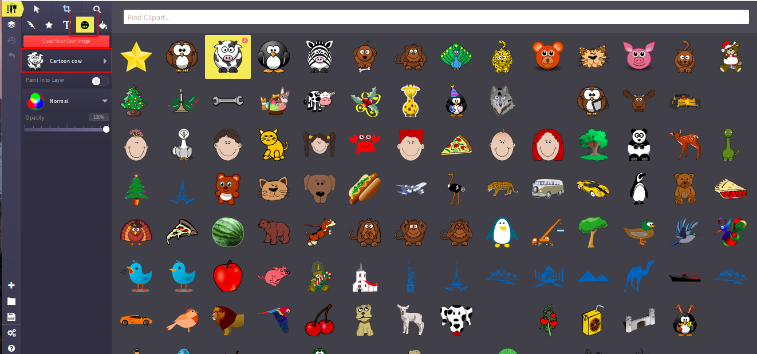
Clipart in Sketchpad
you can use one from here to design your poster

Slide 4
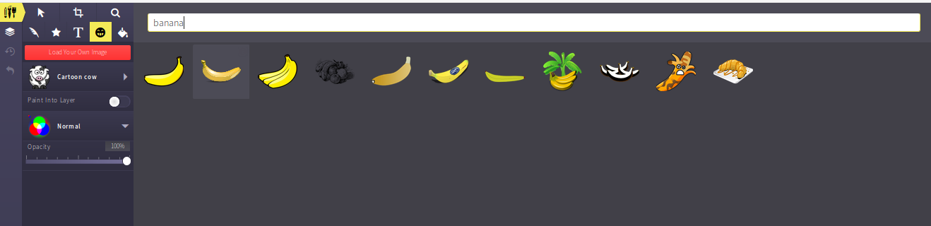
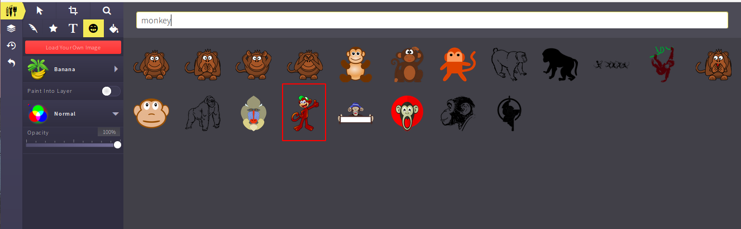
Monkey and Banana Poster
search monkey and banana
tree from the clip art then
add some text on it

Slide 5

Monkey and Banana Poster
Add some suitable texts with it

Slide 6

Monkey and Banana Poster
Text Added

Slide 7

Monkey and Banana Poster
Change Background
color

Slide 8



